Slide 1

Housing Market Prediction Model
Project #4

Slide 2
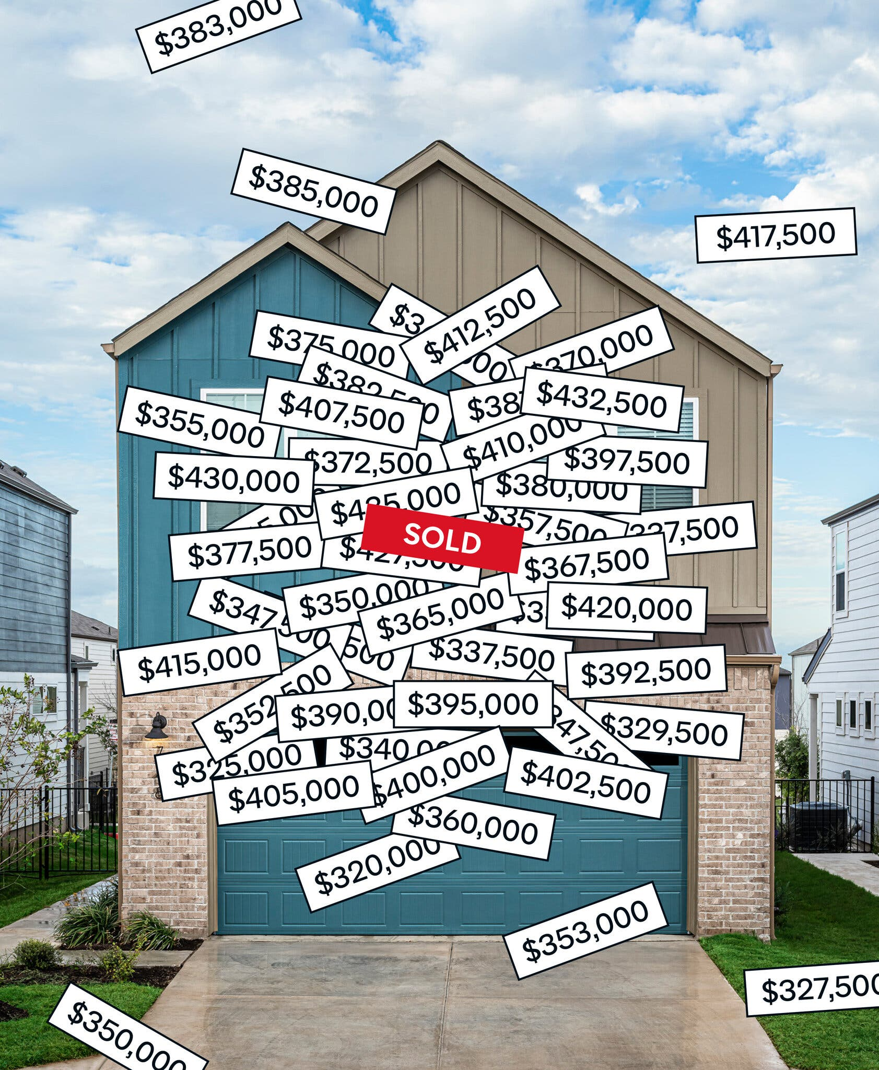
Project Team:
Joseph March
Diane Tiblin
Bonnie Bailey

Slide 3
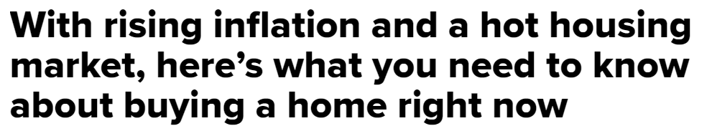
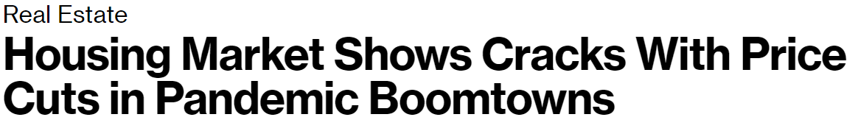
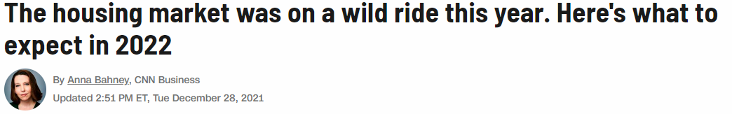
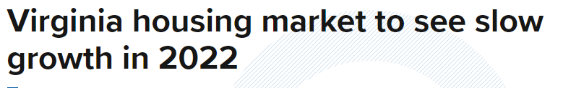
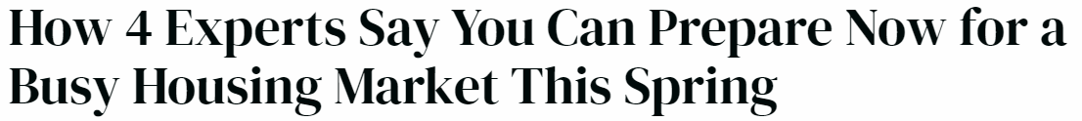
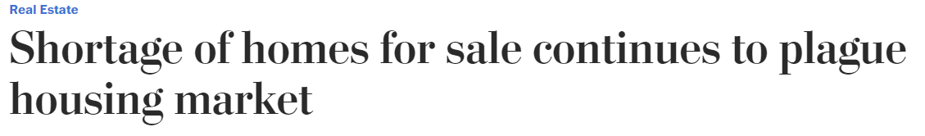
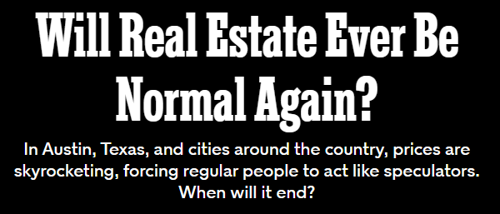
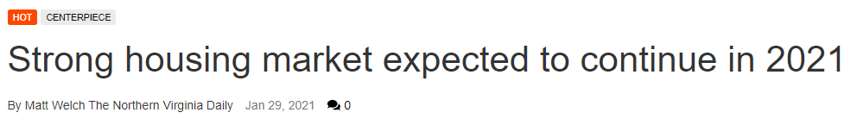
In The News….

Slide 4

Background
At the start of the pandemic, stay at home orders and fear prompted fewer buyers looking for new property and fewer sellers willing to allow strangers into their homes for viewings. Home showings and new listings were down more than 40%
By late spring, the market began to rebound. Decreased interest rates combined with stimulus payments incentivized citizens.
Housing supply, however, could not keep up. This left a small inventory of homes available for sale with record numbers of people bidding the sales price of those homes up significantly.
https://www.stlouisfed.org/publications/regional-economist/fourth-quarter-2020/impact-covid-residential-real-estate-market

Slide 5
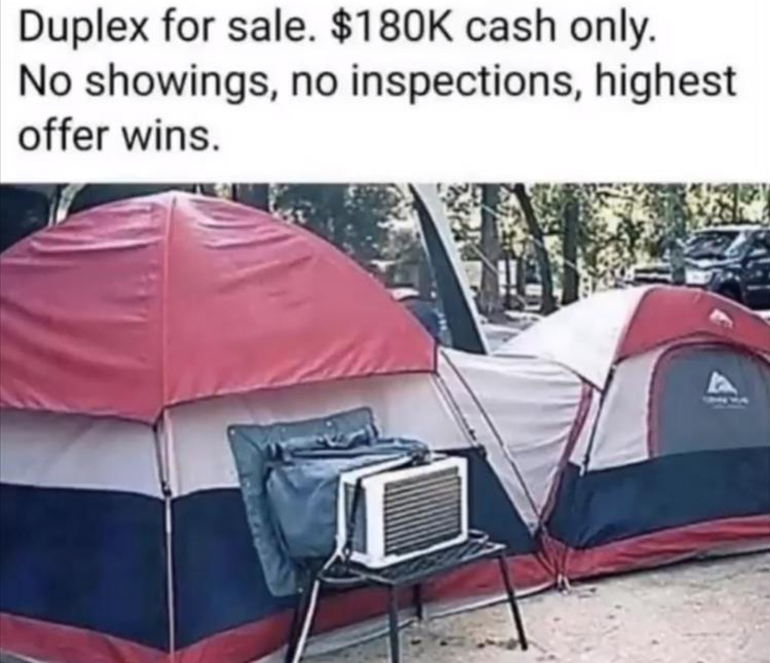
Many renters were now working remotely and finding that without the expense of a commute, they could afford to buy a home in a less metropolitan area. They could also essentially choose to work from anywhere. This began the migration of certain portions of the population.
The high cost of living in larger metropolitan cities began to push people out in search of lower living expenses. “…smaller metro areas are gaining, some famous big cities are slipping, and hints of de-urbanization can be found across the country.”
https://www.linkedin.com/pulse/so-long-big-city-handling-pandemic-often-means-calling-george-anders

Slide 6
Project Topic
Can we make a machine learning model
to predict the market value of houses in an environment
that is highly UNpredictable?

Slide 7
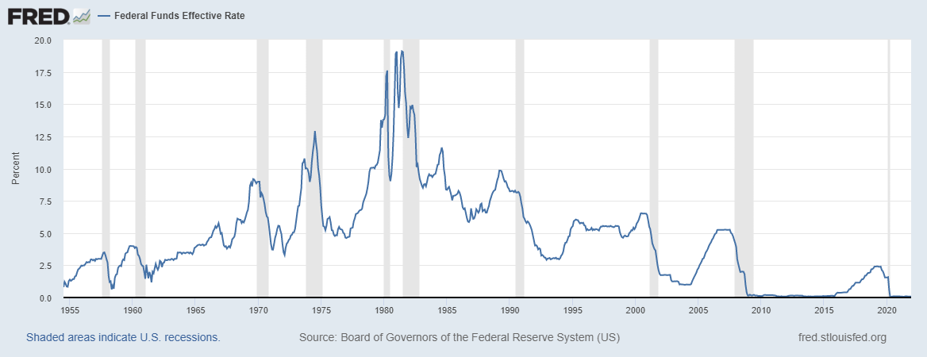
Data Collection
Using data for December 2011-November 2021, we pulled the following:
Zillow- ZHVI for single family residences and condos
Federal Reserve of St Louis- Federal Interest Rates
US Census Data - population, ethnicity, poverty count, income, and housing occupancy numbers
Zillow Housing Value Index (ZHVI)- A smoothed, seasonally adjusted measure of the typical home value and market changes across a given region and housing type. It reflects the typical value for homes in the 35th to 65th percentile range.

Slide 8
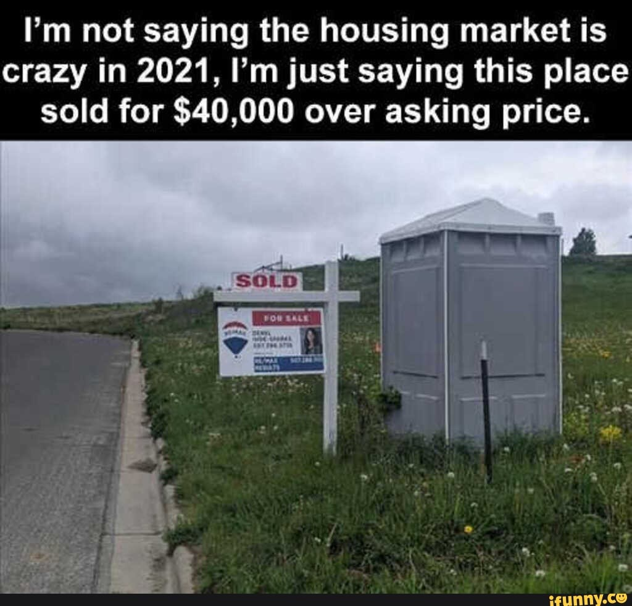
Coding
Pulled API data from US Census.
Cleaned the data by modifying headers, formatting data and converting to rates.
Uploaded Zillow and Federal Funding data to AWS in S3 buckets.
Pulled Zillow and Federal Funding data using PySpark.
Cleaned MSA columns so Census data would match Zillow in order to join data frames together.
Converted Federal Funding data into lists to join to the merged data frame with date columns.
Removed duplicate and non-zero values from the merged data frame. Performed one-hot encoding on the categorical data.
Scaled the data.
Created and tested linear regression model.

Slide 9
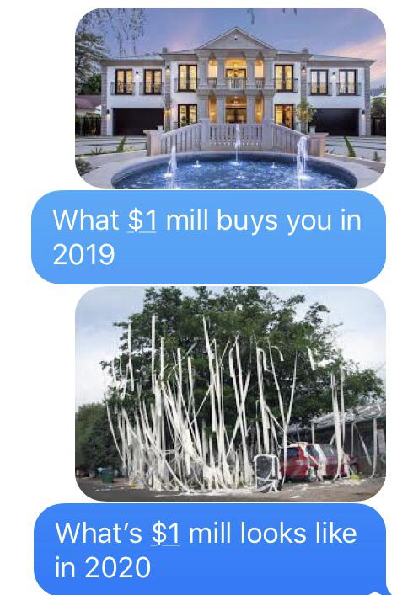
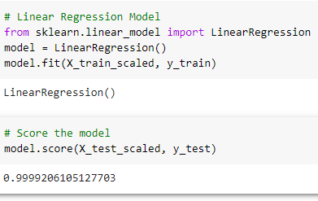
Linear Regression Model

Slide 10
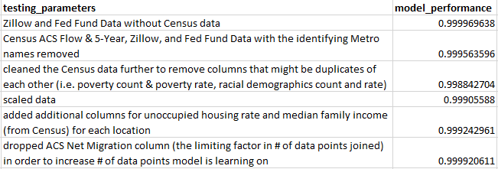
Model Performance

Slide 11
Challenges: - Difficulty finding free data on property sales. - Slight narrowing of our data source with the elimination of fields with null data or duplications. - Data was limited to metropolitan areas and the suburbs surrounding. Results/Findings: - A model can be created to predict the market value to within 99.99% accuracy within a metropolitan area. Note: The housing market is naturally unpredictable as a result of human behavior.

Slide 12
How Could we Expand the Project:
- Currently the model predicts one month ahead. With additional work the model could be expanded to predict further into the future. - Currently the model predicts averages within a metropolitan area. With funding, data could be pulled for individual properties.

Slide 13
References
Data Sources:
US Census:
[https://www.census.gov/data/developers/data-sets.html](https://www.census.gov/data/developers/data-sets.html)
FRED Economic Data:
https://fred.stlouisfed.org/series/FEDFUNDS
Zillow:
Zillow Home Value Index- Metro US
https://www.zillow.com/research/data/

Slide 14
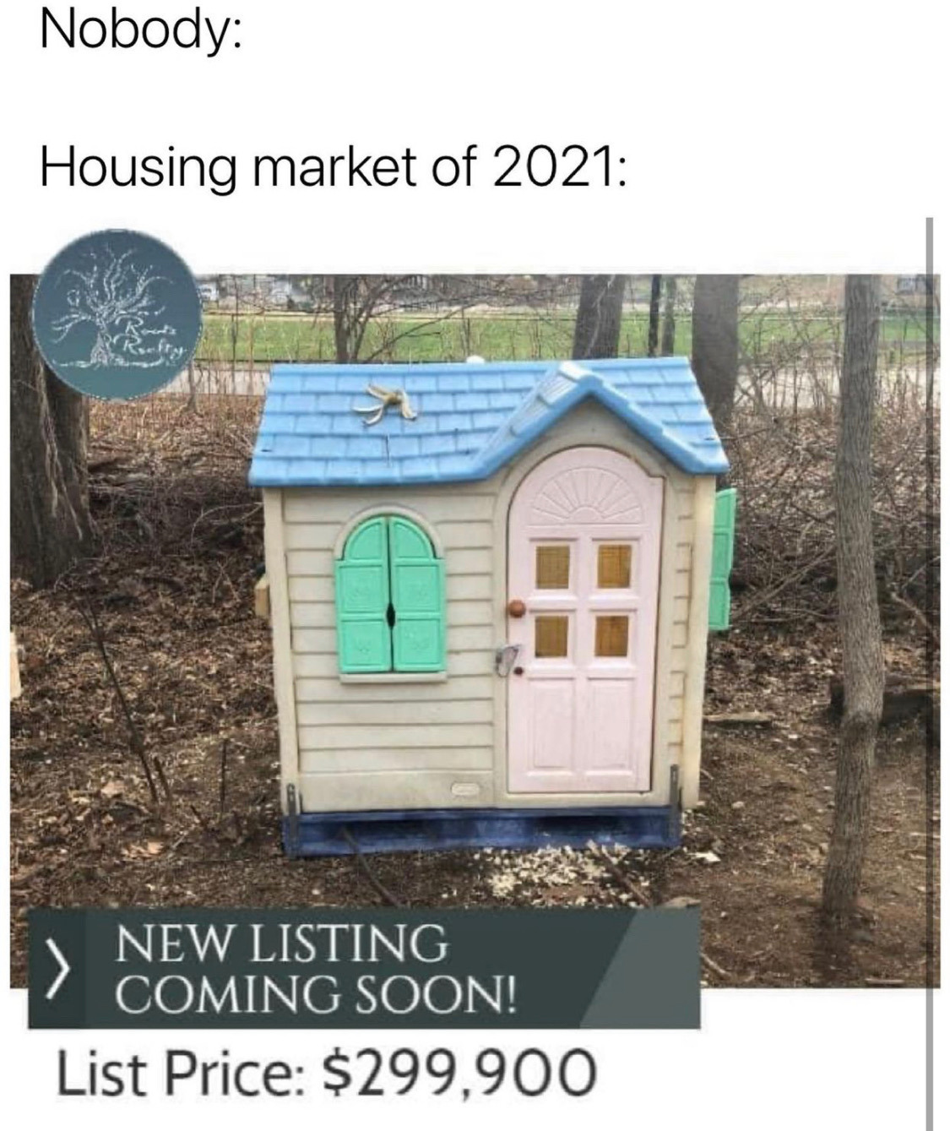
Questions??

